Slide 1

Optimizing MoveIt
Costs, Constraints and Betterments
October 19, 2023
Lars Henning Kayser
MoveIt Chief Architect henningkayser@picknik.ai

Slide 2
Quick facts
about me
2018
M.Sc. CS at University of Hamburg, TAMS robotics lab
Hired by PickNik after introduction at ROSCon Madrid
Since then
20+ clients, leading 6 projects
industrial, medical, construction, agriculture, logistics, …
primarily consulting and R&D, motion planning - MoveIt, C++
MoveIt ROS 2 migration, ROSin project (EU Horizon 2020)
Now: MoveIt Chief Architect (or Archeologist?)
OSS Maintenance, internal R&D, TSC member

Slide 3


Optimizing MoveIt
01
Inverse Kinematics
Solving / Sampling / Optimizing
02
Motion Planning
Searching / Optimizing / Ranking
03
Miscellaneous
Projects / Python / Parameters / PRs

Slide 4
Inverse Kinematics
Solving / Sampling / Optimizing

Slide 5
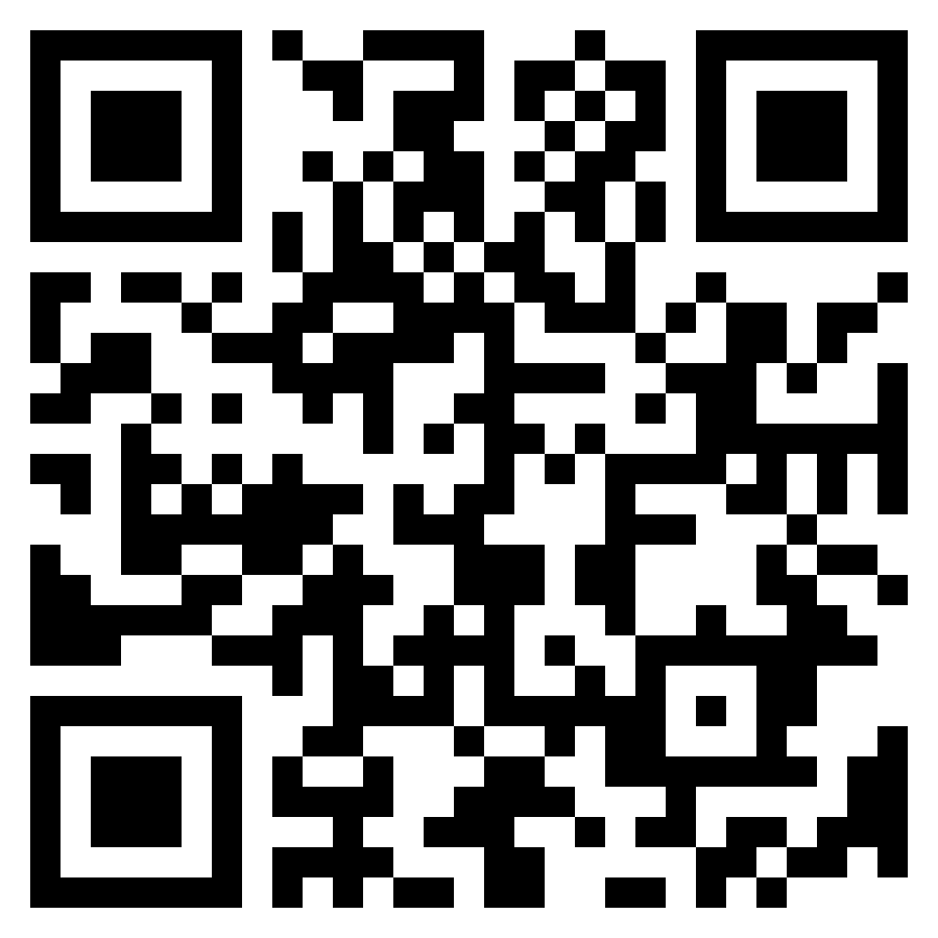
IK - Problem
Example: Turtle Cleaning Robot
repo: https://github.com/henningkayser/roscon23_moveit
Problem: Find initial robot state to gently apply scrubber!

Slide 6
IK - Solvers
Configuration: kinematics.yaml
Solver Plugins
IKFast
repo: MoveIt
KDL
repo: MoveIt
trac_ik
repo: https://bitbucket.org/traclabs/trac_ik/src/rolling-devel/
bio_ik
repo: https://github.com/TAMS-Group/bio_ik
ros2: https://github.com/PickNikRobotics/bio_ik/tree/ros2
pick_ik
repo: https://github.com/PickNikRobotics/pick_ik
manipulator:
kinematics_solver: kdl_kinematics_plugin/KDLKinematicsPlugin
…
C++ Implementation
// … initialize:
// RobotState target_state
// JointModelGroup arm_group
// PoseStamped turtle_pose
PoseStamped target_pose = turtle_pose;
target_pose.pose.position.z += turtle_radius;
target_state.setFromIK(arm_group, target_pose);

Slide 7
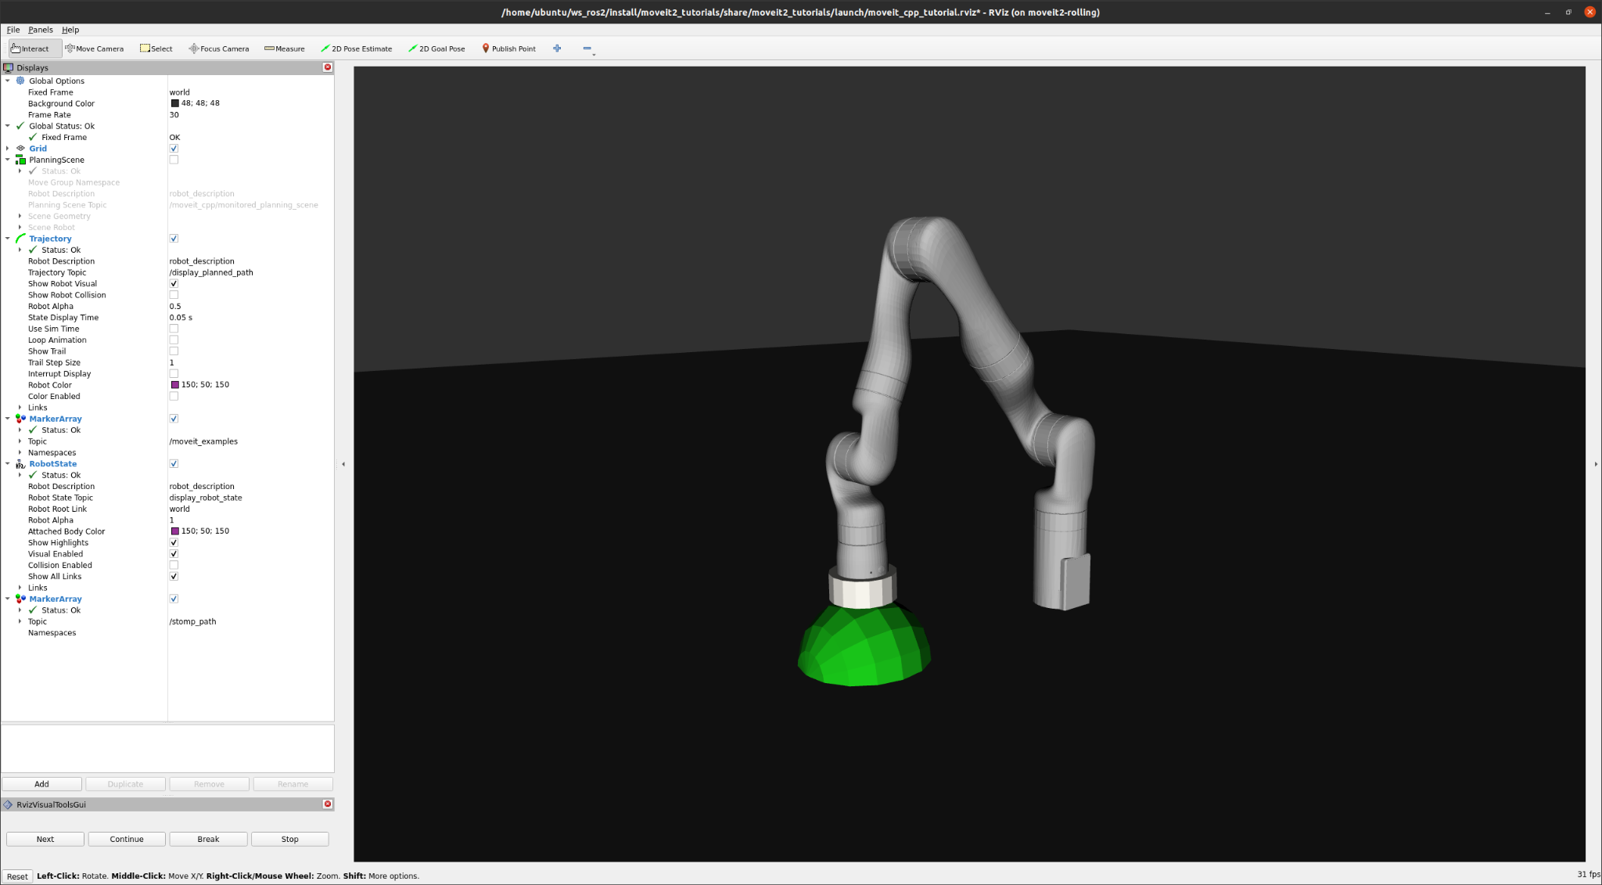
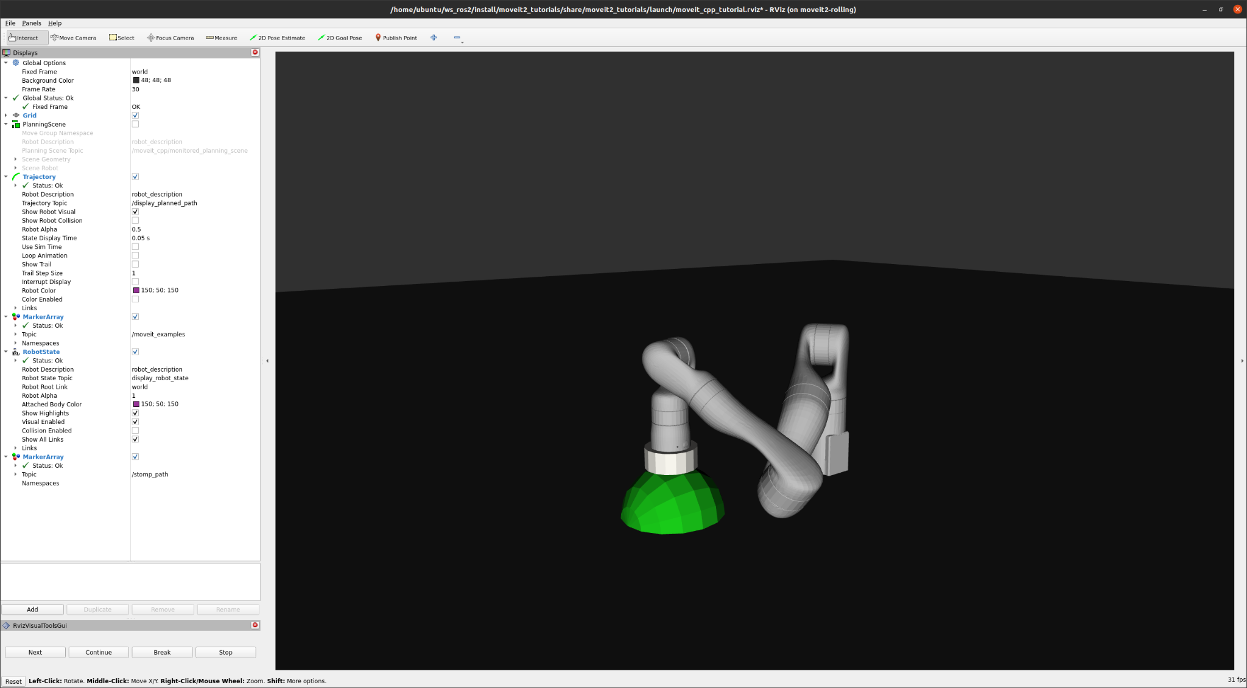
IK - Solution
Very often
Sometimes

Slide 8
IK - Limitations
We don’t always want or need fully constrained target poses
Tools can often be applied with some tolerance
Suction grippers, laser scanning, spin scrubbers …
We may compromise orientation accuracy for position accuracy
Laser cutting, welding, assembly
Unstructured robot environments may require
Additional safety margins, collision clearance
Reachability issues may lead to
joint flips, high failure rate, solutions near singularities or joint limits
We can increase the solution space using problem-specific constraints!

Slide 9
IK - Constraints
Constraints are rules that decide the binary validity of a state
Implementation types
Threshold functions with target value and tolerance range
Bool functions that perform on non-gradient metrics
MoveIt supports
Position, Orientation, Joint, Visibility constraints
Collisions, joint limits are implicitly constraining solutions

Slide 10
IK - Position Constraint
We can model the space of valid poses as single position constraint!
PositionConstraint (moveit_msgs)
std_msgs/Header header turtle pose frame
string link_name IK link
geometry_msgs/Vector3 target_point_offset IK frame offset, turtle radius along Z-axis
moveit_msgs/BoundingVolume constraint_region tiny primitive shape, sphere at center of turtle
float64 weight (unused for now)

Slide 11
IK - Constraint Sampler
#include <moveit/constraint_samplers/constraint_sampler_manager.h>
#include <moveit/kinematic_constraints/utils.h>
// … init std::string link_name, PlanningScene scene
geometry_msgs::msg::PointStamped target_point;
target_point.header = turtle_pose.header;
target_point.point = turtle_pose.pose.position;
geometry_msgs::msg::Point link_offset;
link_offset.z = turtle_radius;
using kc = kinematic_constraints;
auto constraints = kc::constructGoalConstraints(link_name, link_offset, target_point);
constraint_samplers::ConstraintSamplerManager sampler_manager;
auto goal_sampler =
sampler_manager.selectSampler(scene, arm_group->getName(), constraints);
goal_sampler->sample(target_state);

Slide 12
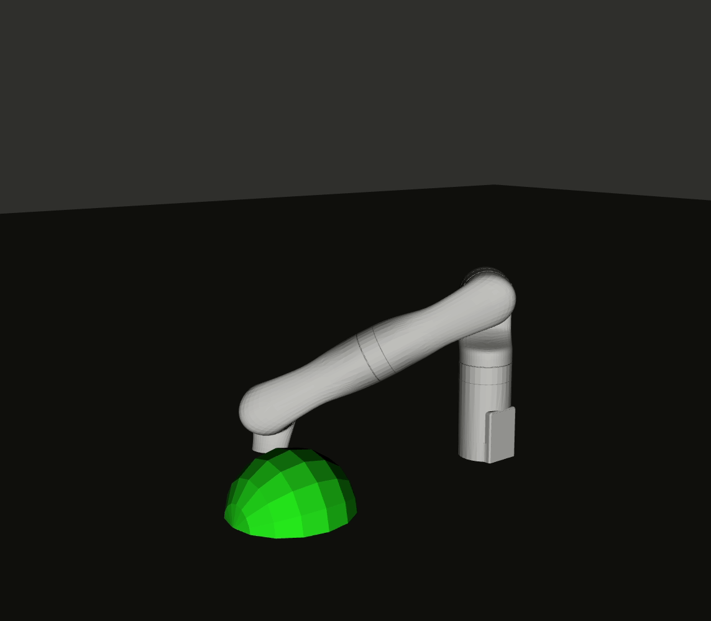
IK - Constraint Sampler
Obviously, collision checks are not enabled here.
We either have to reject a lot of samples (costly!) or add additional constraints.

Slide 13
IK - Solution Quality
What if we want quality criteria like …
reducing the joint distance from the current configuration
repeatable or at least similar solutions
preference for contact points near an ideal target
… and all that at the same time?

Slide 14
IK - pick_ik
Plugin Implementation
Thread-safe reimplementation of bio_ik
Provides gradient descent (local) and memetic (global) optimization
Built-in cost objectives
minimal displacement
center joints
avoid joint limits
Supports dynamic parameter updates
Configuration: kinematics.yaml
manipulator:
kinematics_solver: pick_ik/PickIkPlugin
mode: global # global, local
position_scale: 1.0 # factor for position distance cost
rotation_scale: 0.5 # factor for rotation distance cost
position_threshold: 0.005 # max allowed position cost
orientation_threshold: 0.01 # max allowed orientation cost
minimal_displacement_weight: 0.0 # minimize seed distance
center_joints_weight: 0.0 # keep joint values centered
avoid_joint_limits_weight: 0.0 # penalize states near limits
… and implements MoveIt’s new IK Cost function API!

Slide 15
IK - Cost Function API
Inject quality metrics into IK solver plugins
IK callback for computing cost values for solver-internal samples
Currently, only supported by pick_ik, bio_ik (ros2 PickNik fork)
// moveit_core/kinematics_base/…/kinematics_base.h, class KinematicsBase
using IKCostFn = std::function<double(const geometry_msgs::msg::Pose& target_pose,
const moveit::core::RobotState& sample_state,
const moveit::core::JointModelGroup* group,
const std::vector<double>& seed_positions)>;

Slide 16
IK - Constraint -> Cost Function
// …
kc::KinematicConstraintSet constraints_validator(robot_model);
constraints_validator.add(constraints, scene->getTransforms());
auto constraints_cost_fn = [&](const geometry_msgs::msg::Pose& /* target_pose */,
const RobotState& sample_state,
const JointModelGroup* /* group */,
const std::vector<double>& /* seed_positions */)
{
return constraints_validator.decide(sample_state).distance;
};
target_state.setFromIK(arm_group,
target_pose,
0.05, /* seconds timeout */
GroupStateValidityCallback(),
KinematicsQueryOptions(),
constraints_cost_fn);

Slide 17
IK - Constraint -> Cost Function
We still pass the initial target pose to the IK call
Setting return_approximate_solution to true allows diverging from it
pick_ik provides additional approximate_* parameters for tuning cost thresholds
// …
auto ik_options = kinematics::KinematicsQueryOptions();
ik_options.return_approximate_solution = true;
target_state.setFromIK(arm_group,
target_pose,
0.05, /* seconds timeout */
GroupStateValidityCallback(),
ik_options,
constraints_cost_fn);

Slide 18
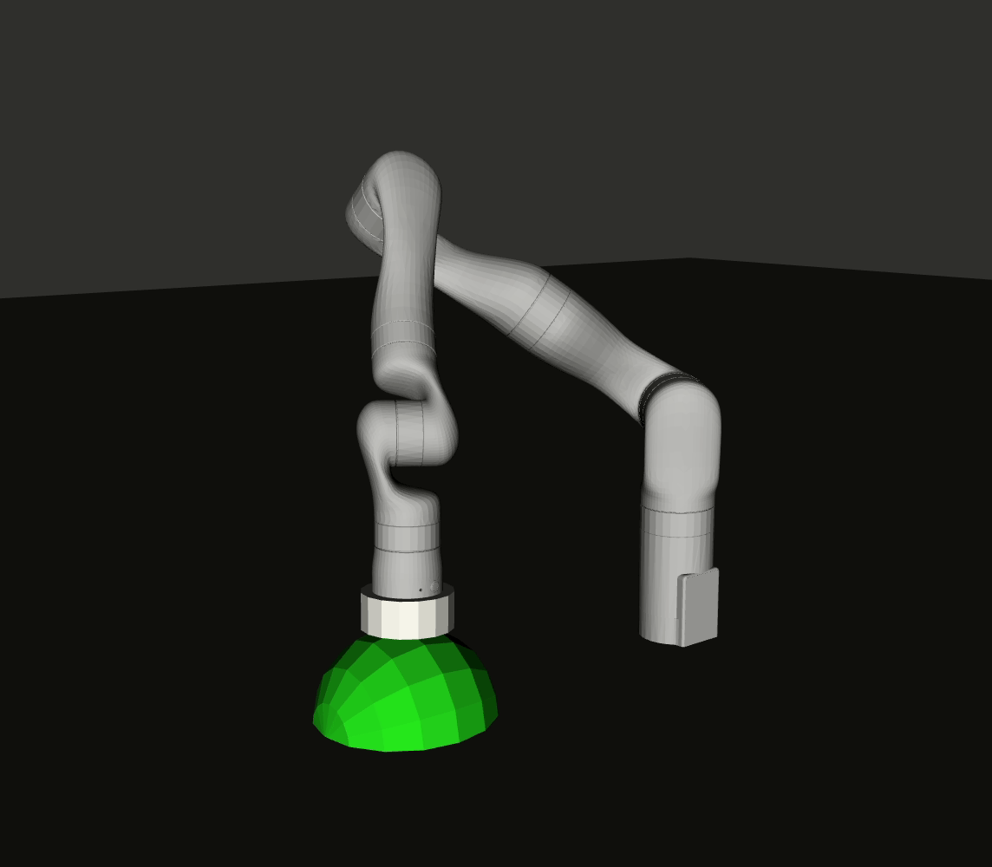
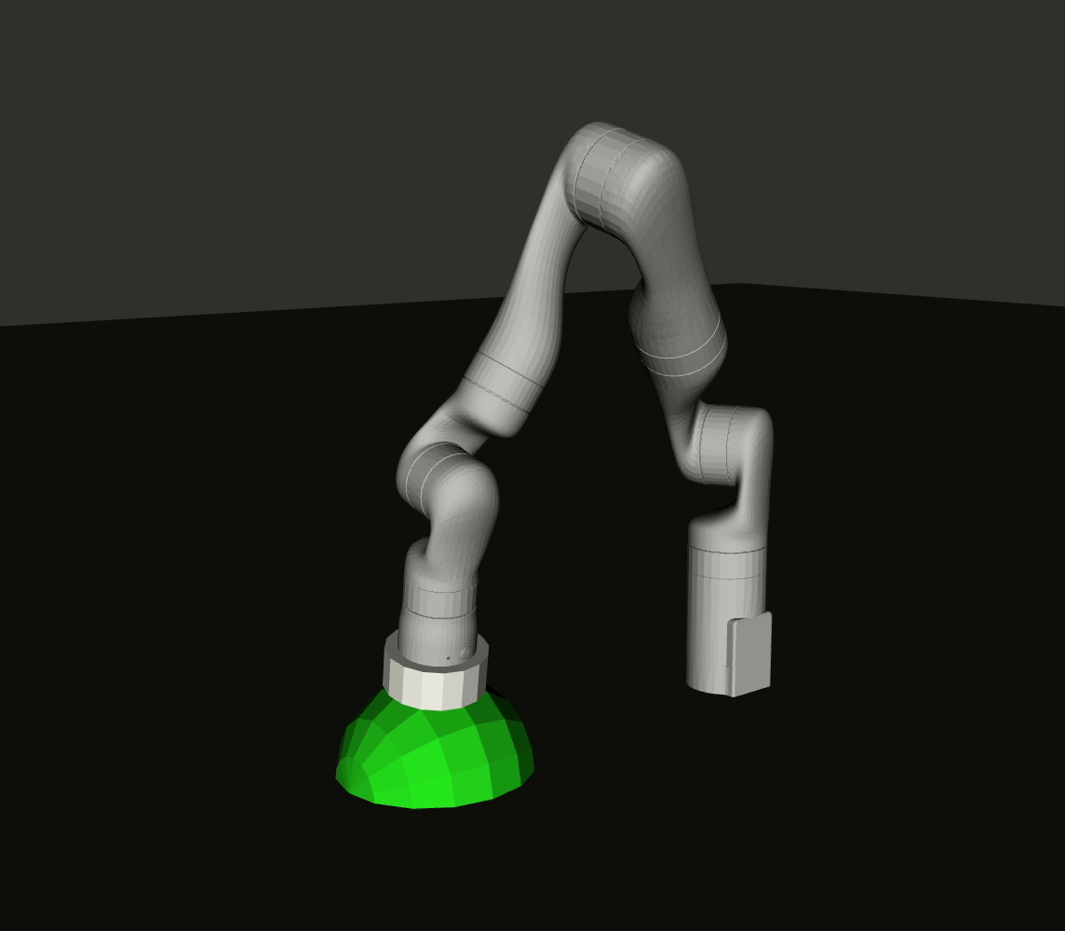
IK - pick_ik Solutions
Same start state (20 solutions)
Random start state (20 solutions)

Slide 19
Optimization-based IK
Advanced Use Cases
Cartesian Interpolation
MoveIt’s Cartesian Interpolator supports IK cost functions!
Visual Servoing
“local” modes are feasible for computing controller waypoints online (requires post-processing)
Collision Clearance
A collision distance check as cost function allows “pushing” the robot away from obstacles

Slide 20
Optimization-based IK
Limitations
Conflicting Cost Terms
“Too many cooks…” - already position and orientation targets may conflict, produce offsets
Performance
cost functions need to be very efficient, otherwise solver time explodes
Weighting
Cost terms are balanced by weight. Tuning them may come close to “magic numbers”

Slide 21
IK - Take Aways
Fully constrained IK can have undesired side effects
restricts solution space too much
can produce reachability issues, joint flips
“bad” IK solutions can cause path sampling and motion planning issues
Constraints define some IK problems more elegantly
increase the solution space
enable trade offs between solution accuracy and quality criteria
IK constraints can be sampled and filtered
Cost Functions allow optimizing quality metrics
cost functions can be derived from constraints with distance metrics
IK Solvers can optimize for multiple weighted cost functions at the same time
Optimization can be global or local, depending on the problem

Slide 22
Motion Planning
Searching / Optimizing / Ranking

Slide 23
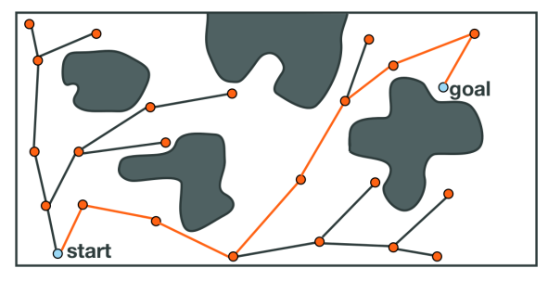
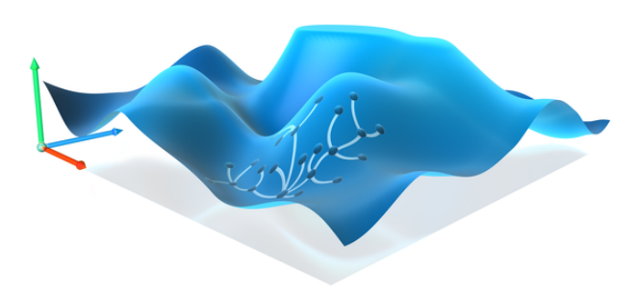
Planning with Constraints (OMPL)
… is very difficult!
OMPL used to sample states in joint space or Cartesian space
joint samples require validation = Rejection Sampling
Cartesian samples require IK
Interpolated states need to be validated as well
Best approach so far was using a search space (= constraint manifold) approximation
pre-computed database with valid states
Sucan et al, IROS 2012!

Slide 24
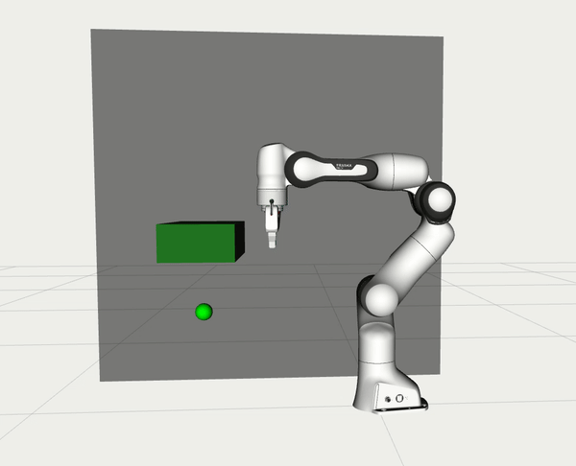
Planning with Constraints (OMPL)
OMPL Constrained Planning
New adapters to OMPL’s constrained planning framework (Kingston, 2019)
Projects sampled states into the constraint manifold using error Jacobian
optimization on constraint derivative gradient
Supports any OMPL planning algorithm
Implemented for Position (BOX), Orientation, and Equality
Tutorial https://moveit.picknik.ai/main/doc/how_to_guides/using_ompl_constrained_planning/ompl_constrained_planning.html

Slide 25
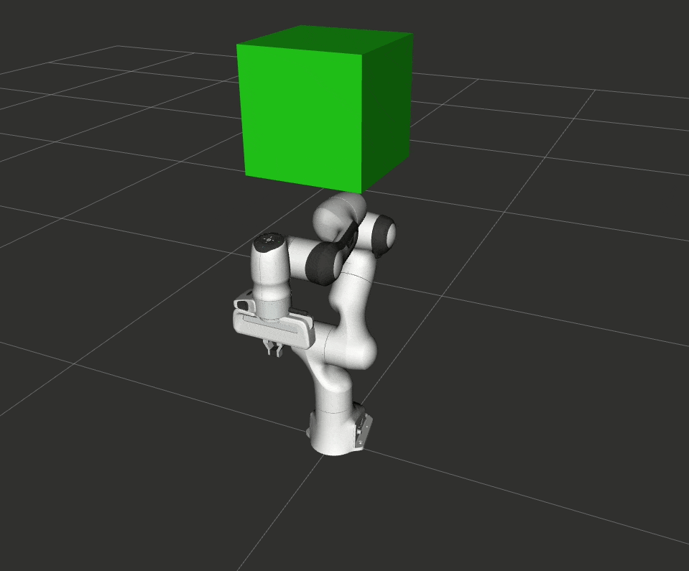
STOMP
Stochastic Trajectory Optimization for Motion Planning
Finds smooth collision free paths using probabilistic optimization
Starts with an initial (maybe infeasible) guess
The initial path is iteratively optimized by minimizing individual waypoint costs over randomized samples
Advantages:
Cost function does not need to be differentiable
Can incorporate additional cost terms

Slide 26
STOMP
Stochastic Trajectory Optimization for Motion Planning
Finds smooth collision free paths using probabilistic optimization
Starts with an initial (maybe infeasible) guess
The initial path is iteratively optimized by minimizing individual waypoint costs over randomized samples
Advantages:
Cost function does not need to be differentiable
Can incorporate additional cost terms
Complete reimplementation!
C++ callbacks instead of plugins
noise, costs, filter, post conditions
supports arbitrary constraints
caveat: probably more useful for post processing OMPL if problem is challenging
NOTE: cost function API similar to CostIKFn() is WIP!
Tutorial https://moveit.picknik.ai/main/doc/how_to_guides/stomp_planner/stomp_planner.html

Slide 27
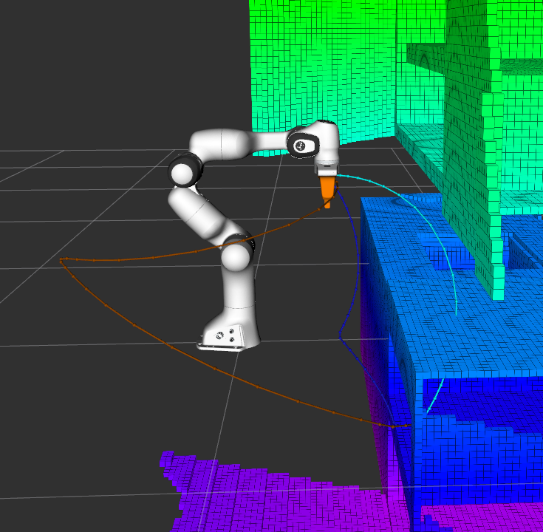
Parallel Planning
Solution quality depends on the planning algorithm
-> Picking the best algorithm for a given problem is not intuitive
Even the “best” algorithm can fail
-> In this case we need a fallback planner
Approach
Run a Portfolio of Planners in parallel and pick the best!

Slide 28
Parallel Planning
Semi-autonomous choice of the most suitable planner for a given problem
Customizable stopping criteria
Customizable solution selection
Good default but no “real” optimization

Slide 29
Miscellaneous
Projects / Python / Parameters / PRs

Slide 30




Major Contributions
GSoC: Python Bindings
Peter David Fagan
GSoC: IK Benchmarking
Mohamed Raessa & Sebastian Castro
GSoC: Servo Refactor
Mohammed Ibrahim & Sebastian Castro
Iron Release
Henning Kayser
Isaac Integration
Marq Rasmussen & Jafar Abdi
Unifying Parameter Approach
Tyler Weaver

Slide 31
Parameters
generate_parameters_library
declarative, validatable and (almost) self-documenting ROS 2 parameters
repo: https://github.com/PickNikRobotics/generate_parameter_library
Visit Tyler Weaver’s talk “Parameters should be boring”!
tomorrow, 2:10 PM CST, “ROS Development” track

Slide 32
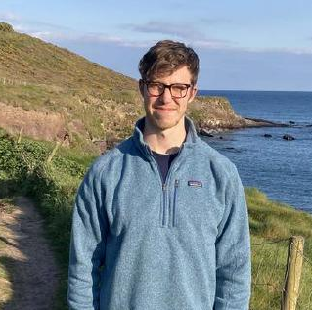
Python Bindings
rclpy.init()
logger = rclpy.logging.get_logger("moveit_py”)
# instantiate MoveItPy instance and get planning component
robot = MoveItPy(node_name="moveit_py")
robot_arm = robot.get_planning_component("arm")
logger.info("MoveItPy instance created")
# set plan start and goal states using predefined states
robot_arm.set_start_state(configuration_name="ready")
robot_arm.set_goal_state(configuration_name="extended")
# plan to goal
arm_motion = robot_arm.plan()
# execute trajectory
if (arm_motion):
robot.execute(arm_motion.trajectory)
moveit_py
2022 GSoC - Peter David Fagan
Python bindings to MoveItCpp and moveit_core classes
Goal: facilitate integrating and prototyping with other Python libraries
Tutorial https://moveit.picknik.ai/main/doc/examples/motion_planning_python_api/motion_planning_python_api_tutorial.html

Slide 33
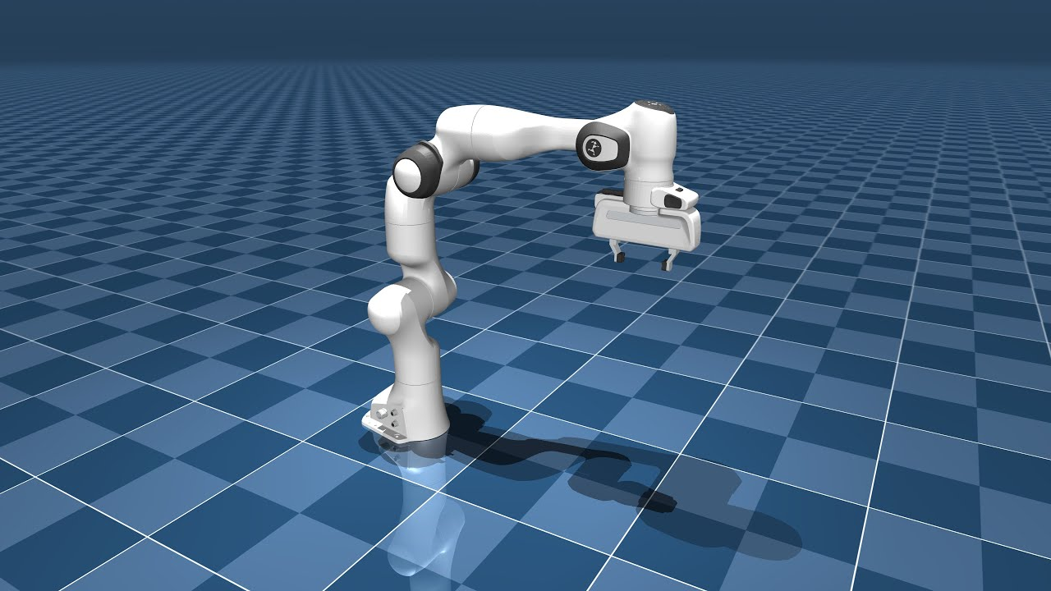
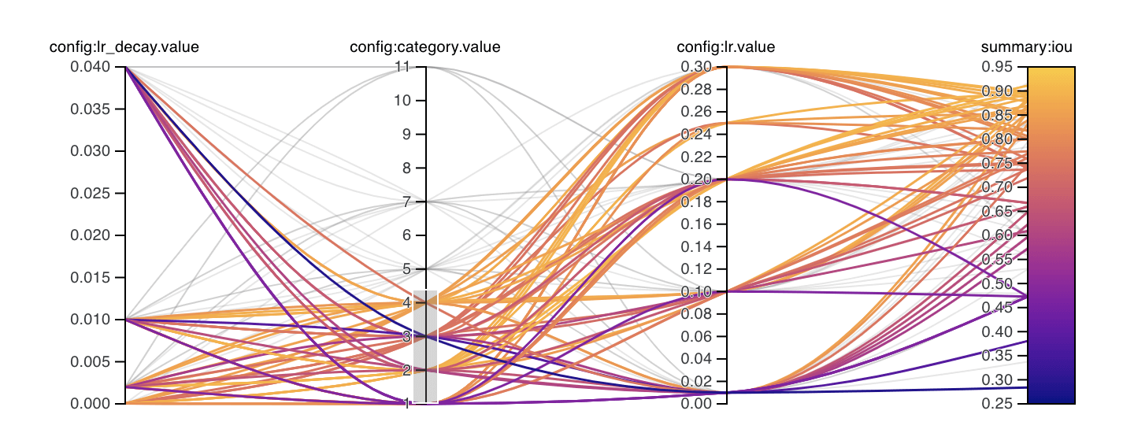
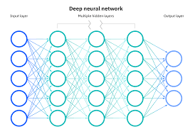
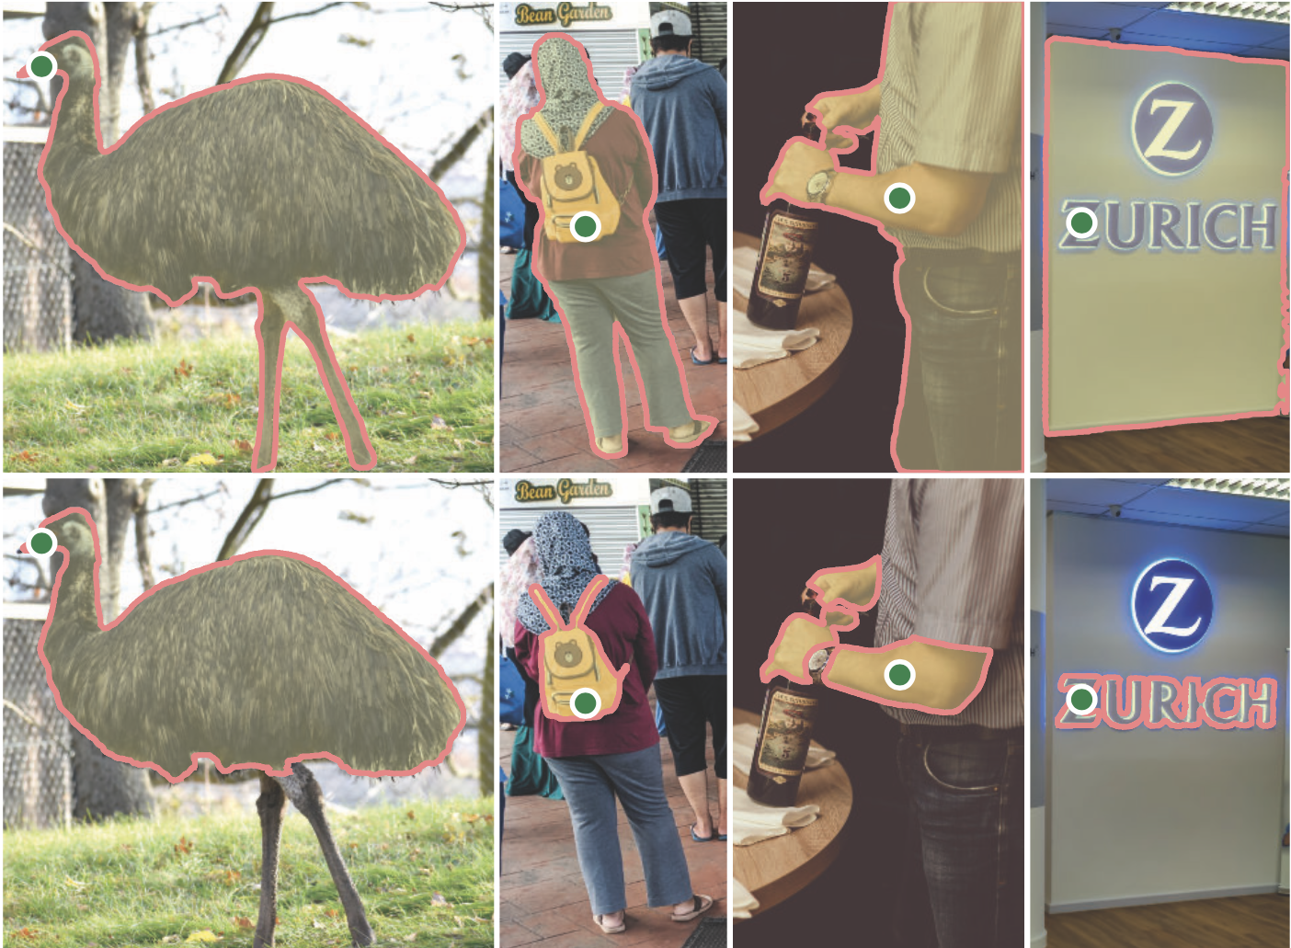
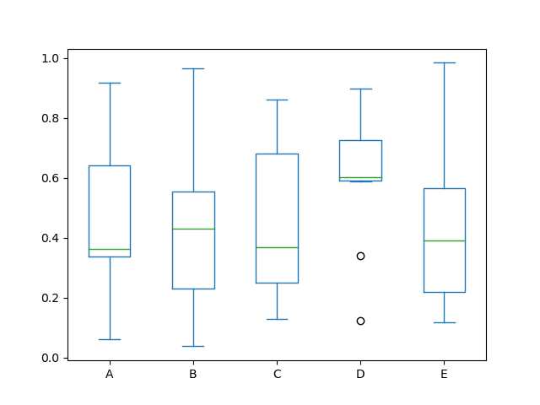
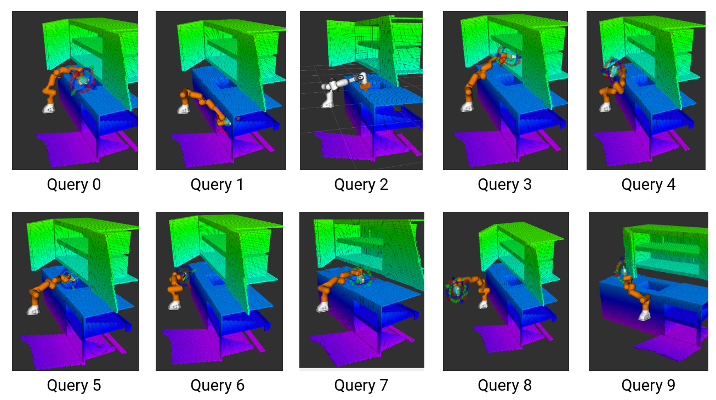
Advanced Use Cases
Simulation
Parameter Tuning
Learning
Perception
Benchmarking
Data Visualization

Slide 34







Future Work? Community!
Grow Community - We want YOU to start playing with this!
What use cases are you interested in?
Which Python library would you like to integrate?
What interfaces do you need for that?

Slide 35
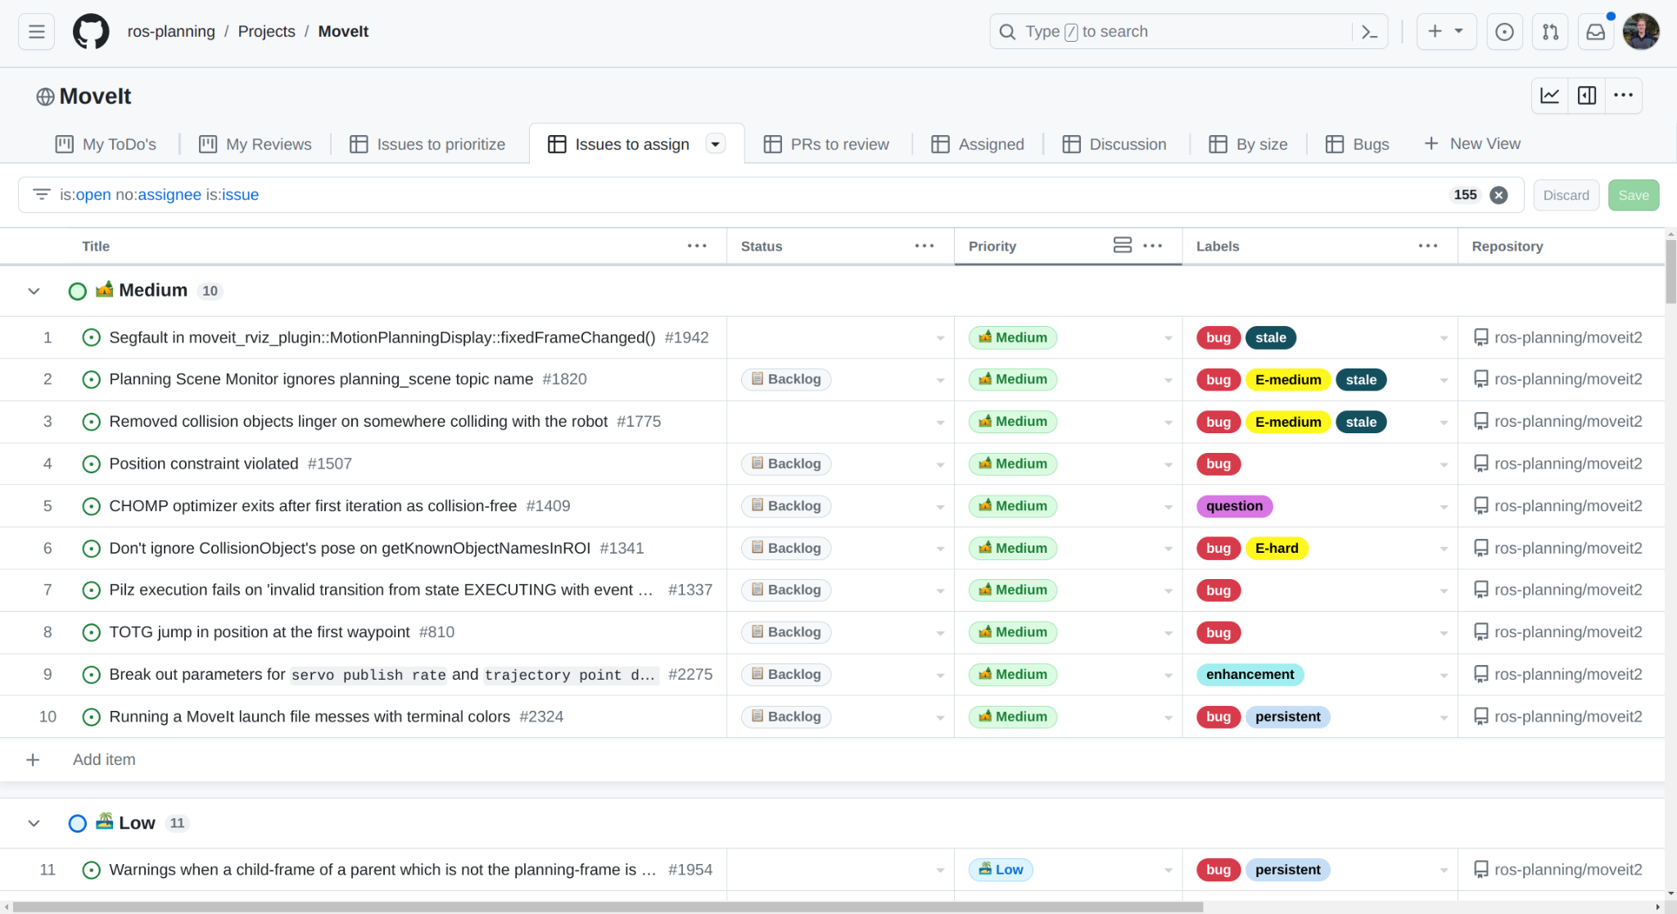

MoveIt Project Planning
Weekly Developer Standup
Tuesdays, 8:30AM Mountain Time
Monthly Working Group /
MoveIt Maintainer Meeting
4th Thursday, 9AM Mountain Time
All contributors are welcome! Request an invite via henningkayser@picknik.ai

Slide 36

Get Involved!
Contribute to MoveIt
Review and file PRs
Engage in issue discussions
Join the meetings
Become a Core Contributor or Maintainer
Apply for GSoC 2024
12+ weeks focused programming Mentored by MoveIt maintainers Details will be shared end of 2023

Slide 37

Thank You!

